Slide 1
COMPUTATIONAL research on METAPHOR
Computational Semantics Seminar
April 25, 2023
Yulia Badryzlova

Slide 2
μεταφορά
μετά «над» + φορός «несущий»
«перенос; переносное значение»

Slide 3
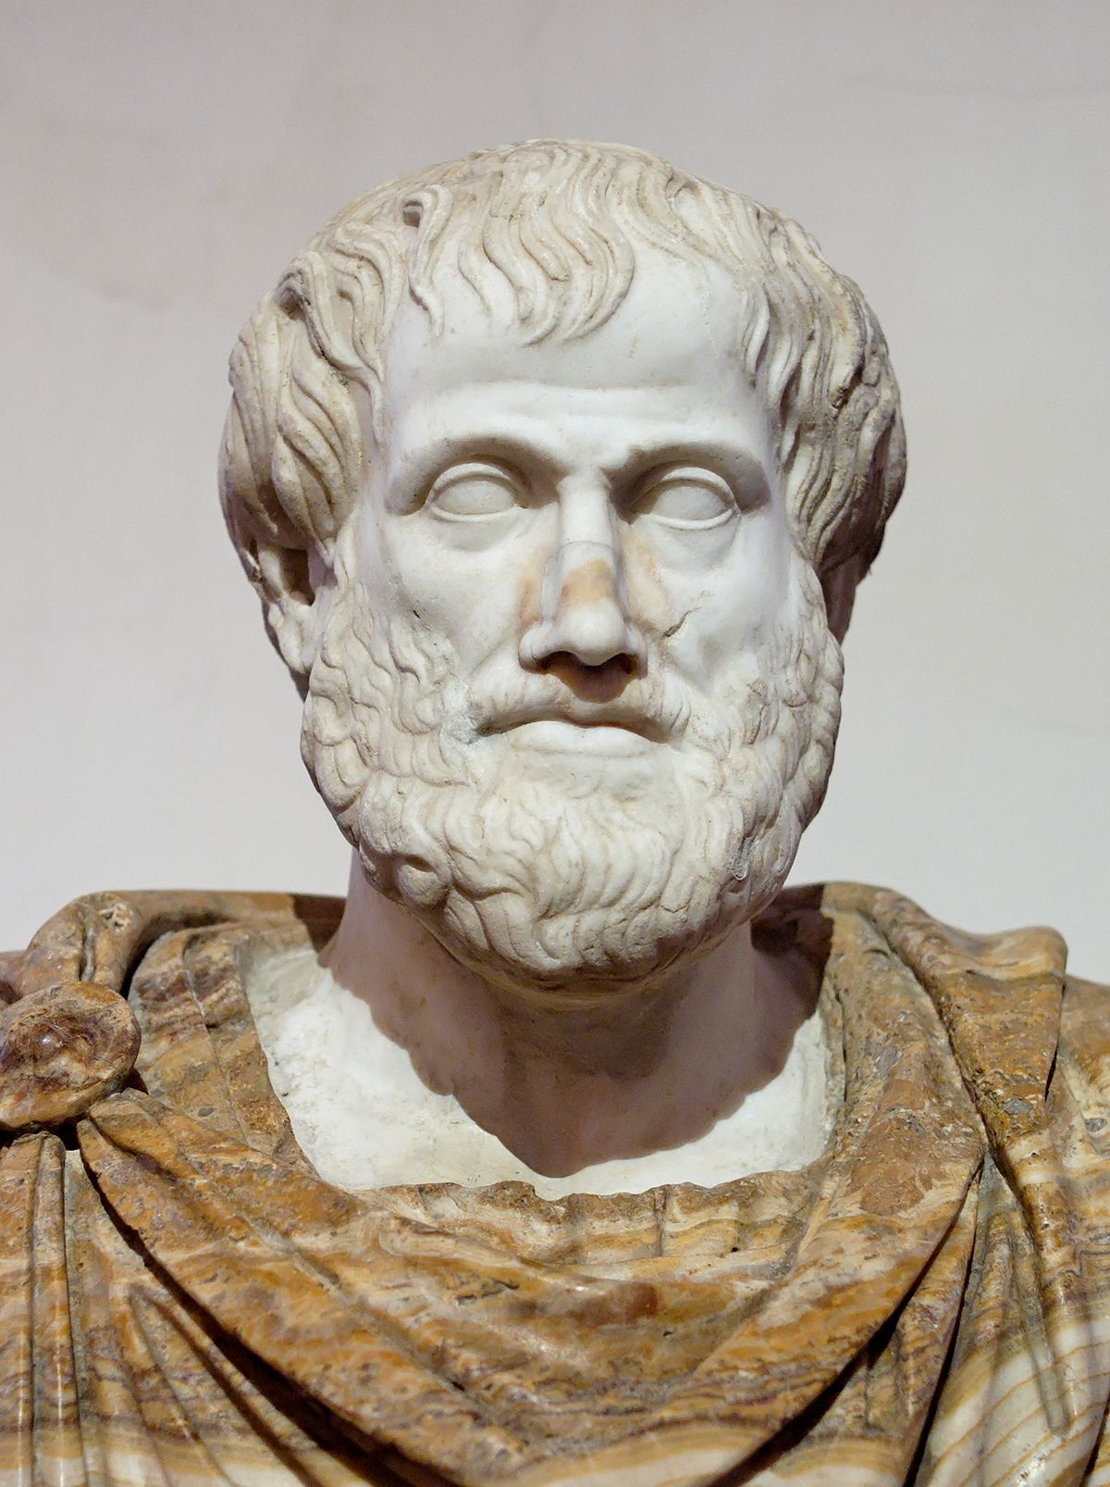
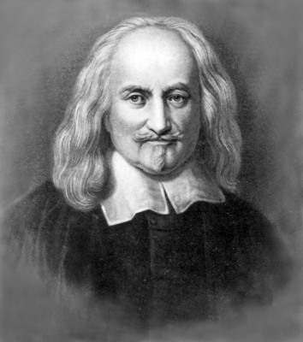
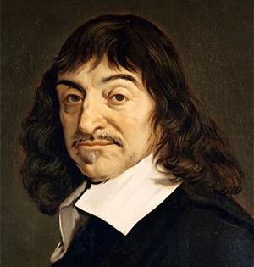
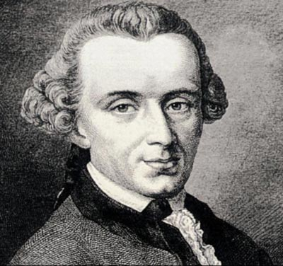
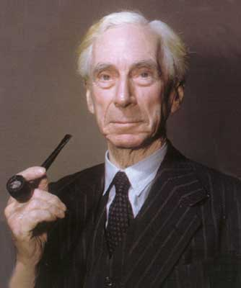
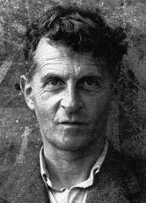
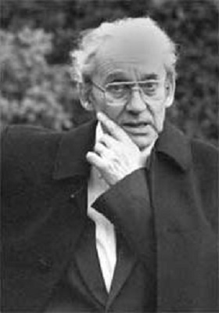
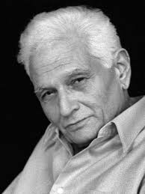
Аристотель
Т. Гоббс
Р. Декарт
И. Кант
Б. Рассел
Л. Витгенштейн
П. Рикёр
Ж. Деррида
Notes:
And that brings up the third and worst assumption — that metaphor is something special and exceptional in the use of language, a deviation from its normal mode of working, instead of the omnipresent principle of all its free action. Throughout the history of Rhetoric, metaphor has been treated as a sort of a happy extra trick with words, an opportunity to exploit the accidents of their versatility, something in place occasionally but requiring unusual skill and caution. In brief, a grace or ornament or added power of language, not its constitutive form.
Richards (1965). The philosophy of rhetoric (p. 90).

Slide 4
The Cognitive Turn

Slide 5

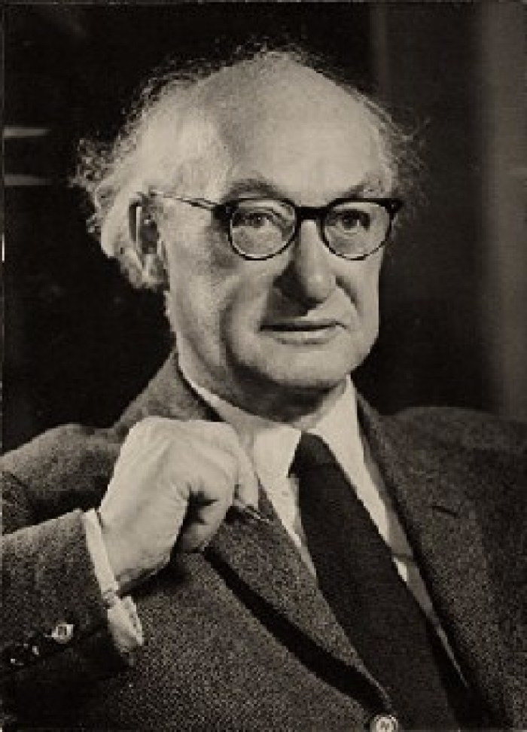
I.A. Richards (1936)
Metaphor is…
an omnipresent principle of the language
the essence of thinking
not so much a manifestation of our experience of the world as the principle by which we construct that world

Slide 6
I.A. Richards
Структура метафоры:
“содержание”, или “основа” (tenor): идея, относительно которой строится метафора
“оболочка”, или “носитель” (vehicle): идея, выражающая это содержание, “то, с чем сравнивается”.
The copresence of the vehicle and tenor results in a meaning which is not attainable without their interaction

Slide 7
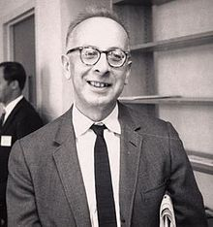
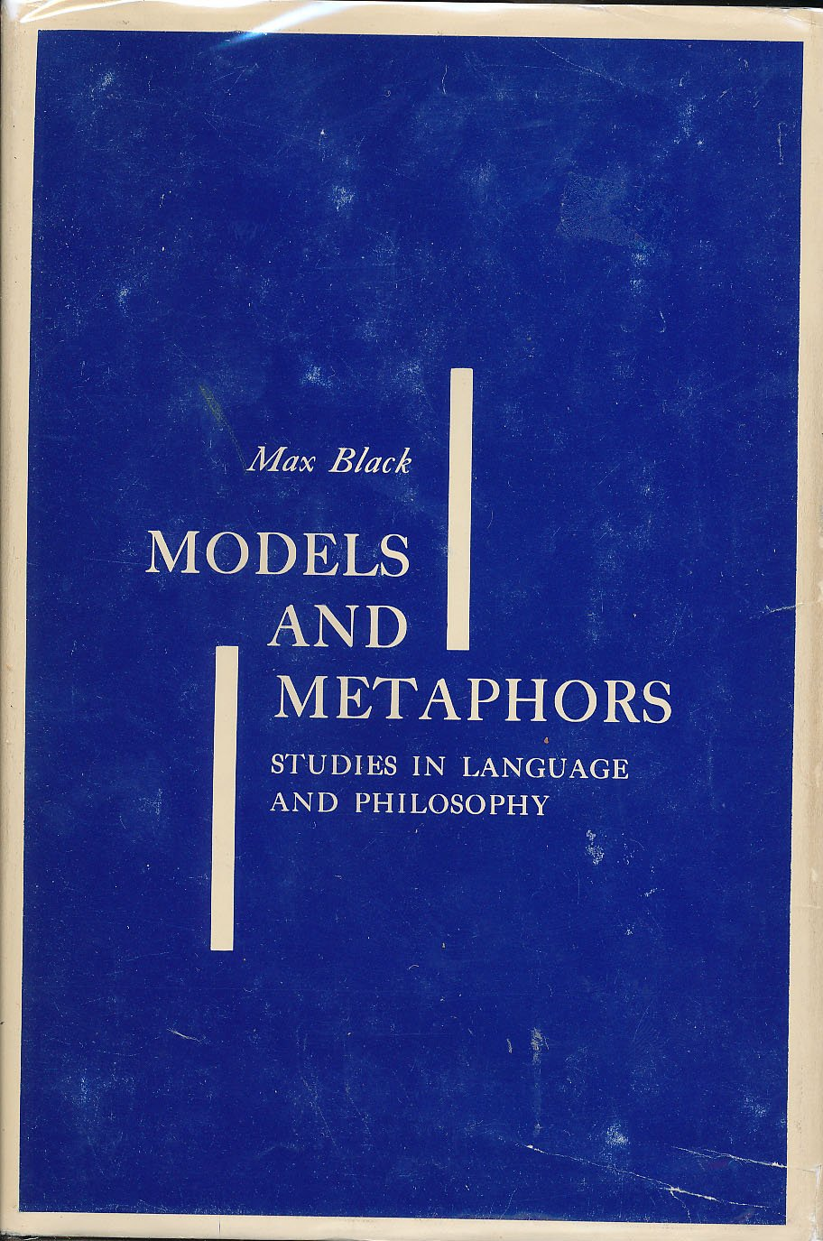
The interaction theory of metaphor
M. Black (1962)
Структура метафоры:
“фокус” (focus)
“рамка” (frame)
Метафора является результатом взаимодействия этих двух объектов, в процессе которого происходит расширение, сдвиг в значении.

Slide 8
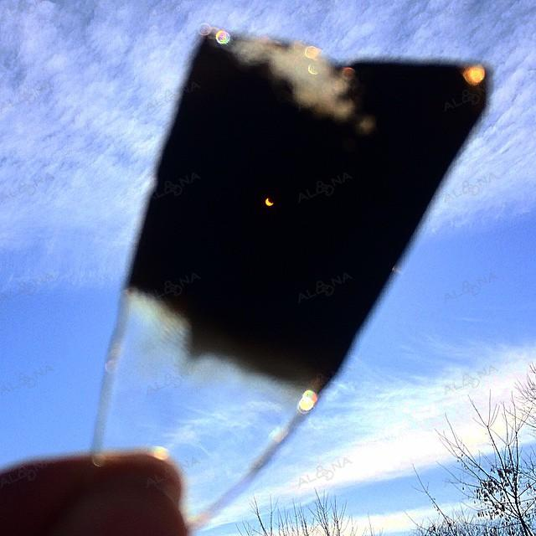
M. Black
Взаимодействуют две системы концептов: к главному объекту применяется система ассоциируемых импликаций, связанных со вспомогательным объектом, в и результате образуется новое, не сводимое к сумме компонентов значение, и интерпретация каждого объекта также изменяется. Метафора в этой схеме действует как особый фильтр ➔ в качестве системы фильтрации задает определенный способ видения объекта («закопченное стекло»).

Slide 9
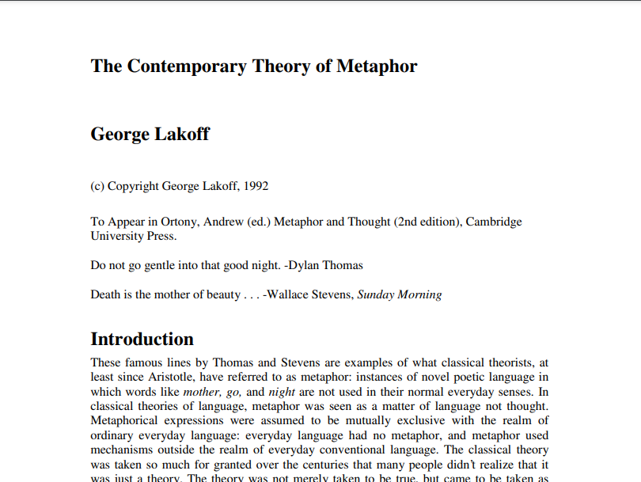
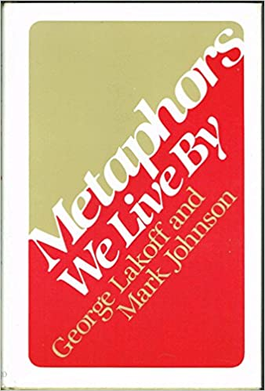
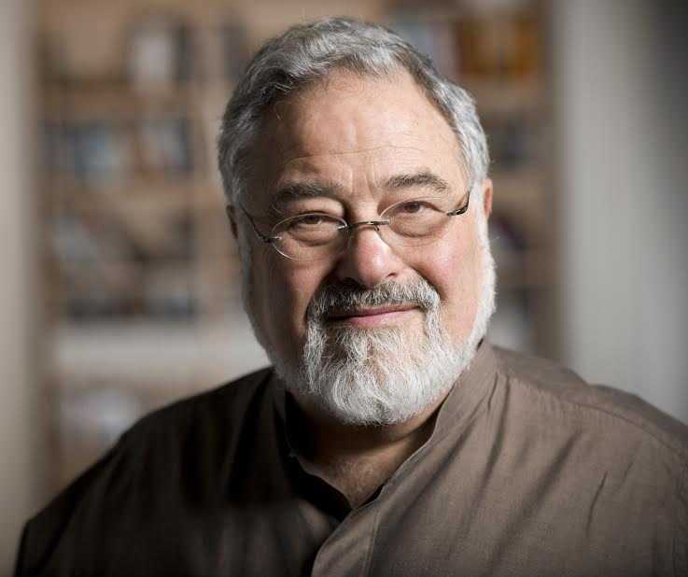
G. Lakoff (1980, 1993)
Метафора – основная ментальная операция, способ познания, категоризации, концептуализации, оценки и объяснения мира
Благодаря метафоре мы можем свести абстрактные понятия к нашему физическому, чувственному опыту в его связи с внешним миром (и значит, понять их). То есть наша понятийная система метафорична по своей сути. “Mental shortcut”.

Slide 10
G. Lakoff
элементы сферы-источника структурируют менее понятную концептуальную сферу-мишень, что составляет сущность когнитивного потенциала метафоры
mapping*
TARGET**
SOURCE**
основана на непосредственном взаимодействии человека с окружающим миром
первичным является физический опыт
менее понятная
более абстрактная
*междоменный перенос / проекция
** концептуальные домены, концептосферы

Slide 11
G. Lakoff
Концептуальные метафоры – глубинные схемы междоменных переносов
e.g. WORDS ARE WEAPONS
Лингвистические метафоры – внешние реализации этих схем
She used some sharp words.
That was pretty cutting language.
It was a barrage of insults.
He was bombarded by insults.
He hurled insults at her.

Slide 12
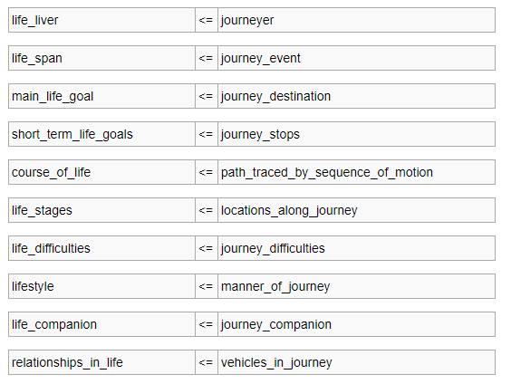
G. Lakoff
Сфера-источник и сфера-мишень представляют собой структуры знаний – состоят из фреймов и сценариев
Метафорическая проекция осуществляется как между отдельными элементами двух структур знаний, так и между целыми структурами концептуальных доменов.
LIFE IS A JOURNEY
Когнитивная топология сферы-источника в некоторой степени определяет способ осмысления сферы-мишени и может служить основой для принятия решений и действия.

Slide 13
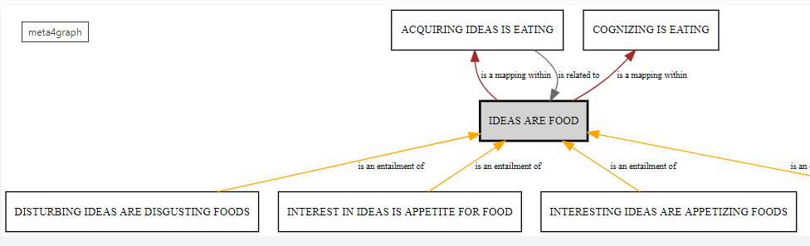
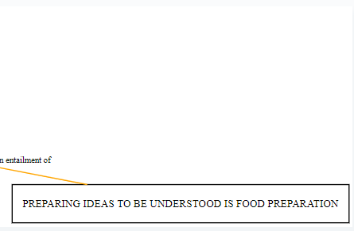
G. Lakoff
Метафорические следствия (entailments): не присутствуют в метафорическом выражении эксплицитно, но выводятся на основе фреймового знания.

Slide 14
G. Lakoff
1. Ориентационные (фиксируют наш опыт пространственной ориентации в мире)
HAPPY IS UP; SAD IS DOWN: I'm feeling up today. He's really low these days.
2. Структурные (использование естественного опыта в одной сфере для определения другой концептуальной области)
TIME IS MONEY/ A COMMODITY: spend time, waste time, budget one’s time
3. Онтологические (апелляция к естественному опыту с физическими объектами и описание абстрактных явлений, например, эмоций, идей как материальных субстанций):
THE MIND IS A MACHINE: We’ve been working on this problem all day and now we’re running out of steam.

Slide 15
Lakoff, G., Espenson, J., & Schwartz, A. (1991). Master Metaphor List
http://citeseerx.ist.psu.edu/viewdoc/download?doi=10.1.1.63.8462&rep=rep1&type=pdf

Slide 16

UNIVERSAL vs. CULTURE-SPECIFIC metaphors
Chinese: LIFE is an OPERA
Yu, N. (2017). Life as opera: A cultural metaphor in Chinese.

Slide 17
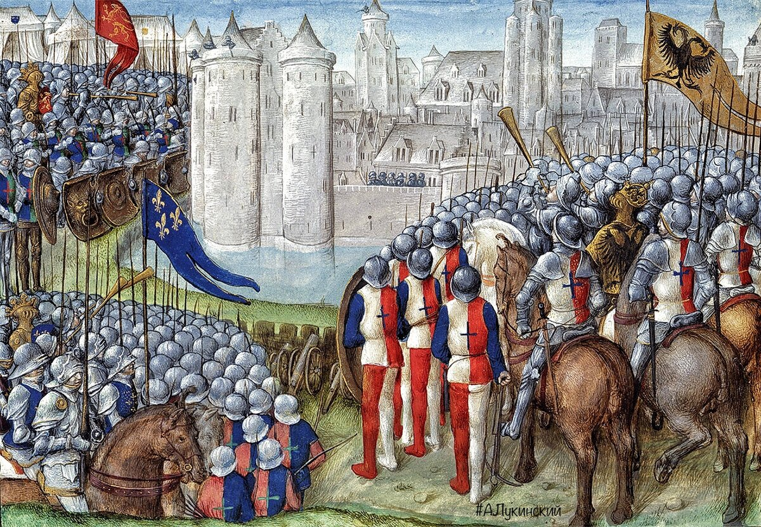
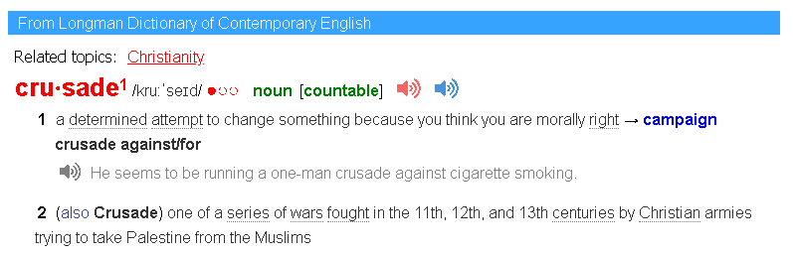
UNIVERSAL vs. CULTURE-SPECIFIC metaphors
CRUSADE

Slide 18


UNIVERSAL vs. CULTURE-SPECIFIC metaphors
beacon of democracy

Slide 19
Role of metaphor in decision-making: metaphorical framing
Political discourse
Media discourse
Educational discourse
Healthcare discourse
etc.

Slide 20
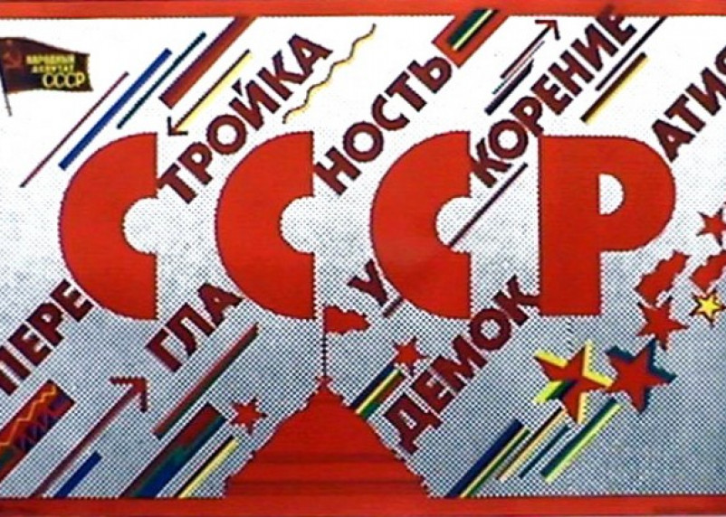
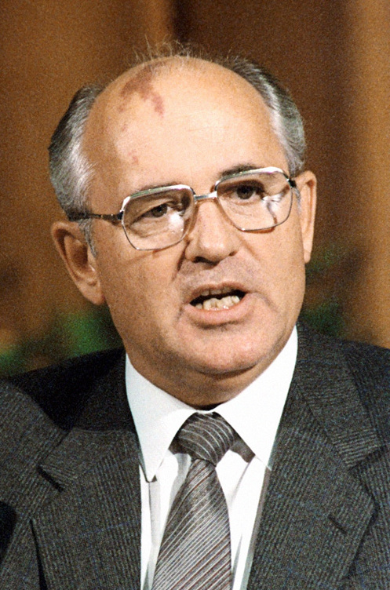

Slide 21
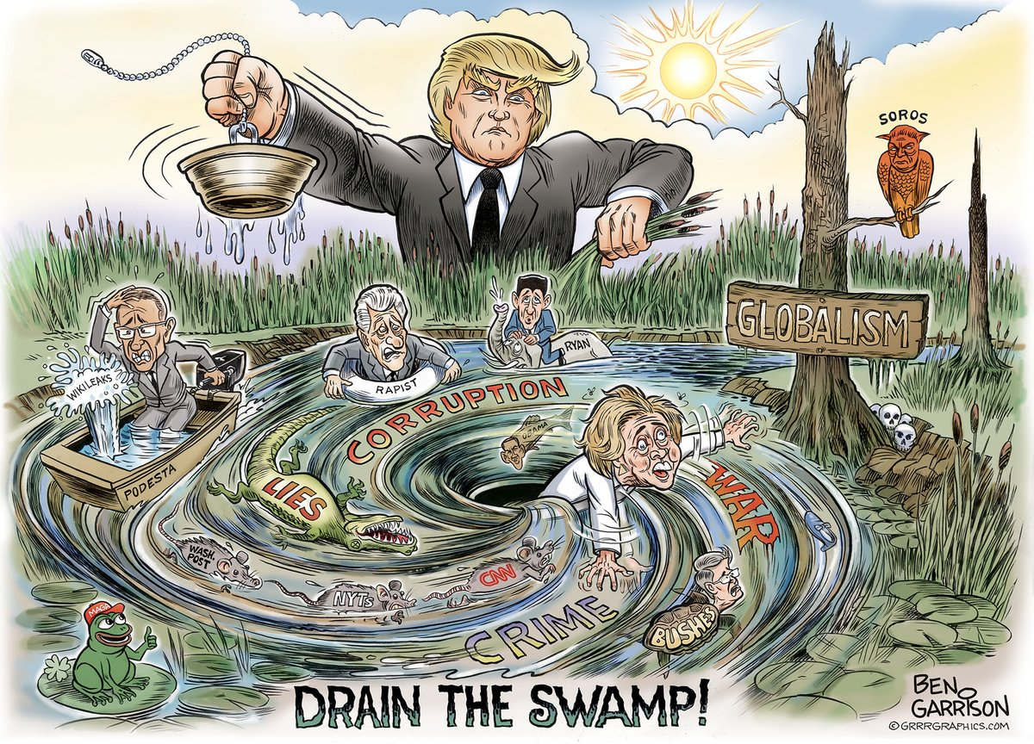

Slide 22
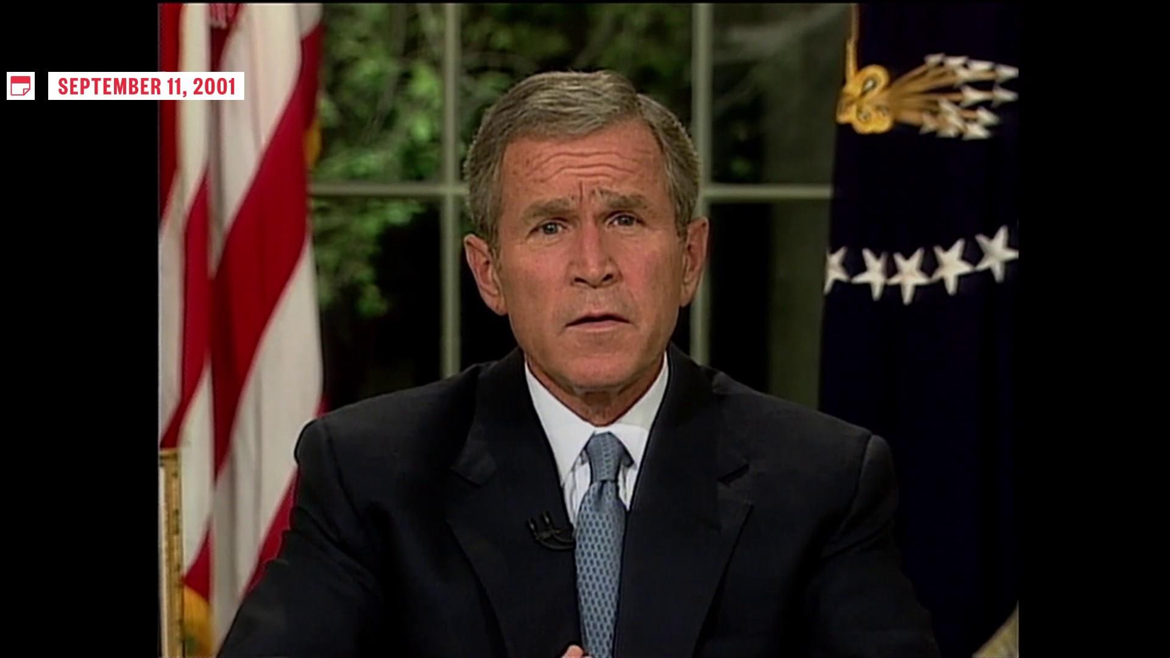
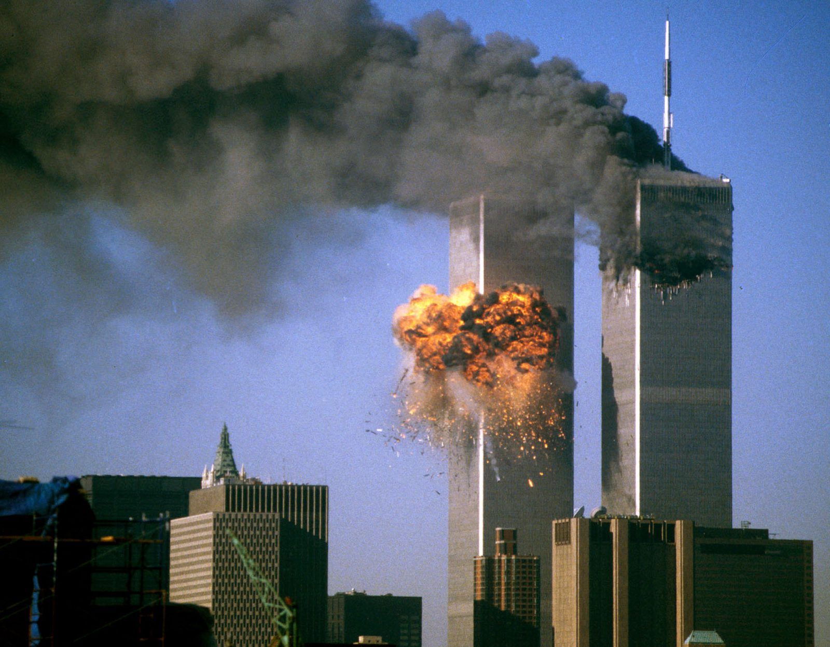
G.W. Bush on September 11 attacks
Charteris-Black, J. (2011). Politicians and Rhetoric. The Persuasive Power of Metaphor, pp. 251-279
Initially, the terrorists may burrow deeper into caves and other entrenched hiding places. (7 October 2001)
It’s an enemy that likes to hide and burrow in and their network is extensive ... But we’re going to smoke them out. (17 September 2001)
My hope is that all nations will heed our call, and eliminate the terrorist parasites who threaten their countries and our own. (29 January 2002)
America encourages and expects governments everywhere to help remove the terrorist parasites that threaten their own countries and peace of the world. (Applause) (11 March 2002)
They support them and harbor them, and they will find that their welcome guests are parasites that will weaken them, and eventually consume them. (12 September 2002)

Slide 23
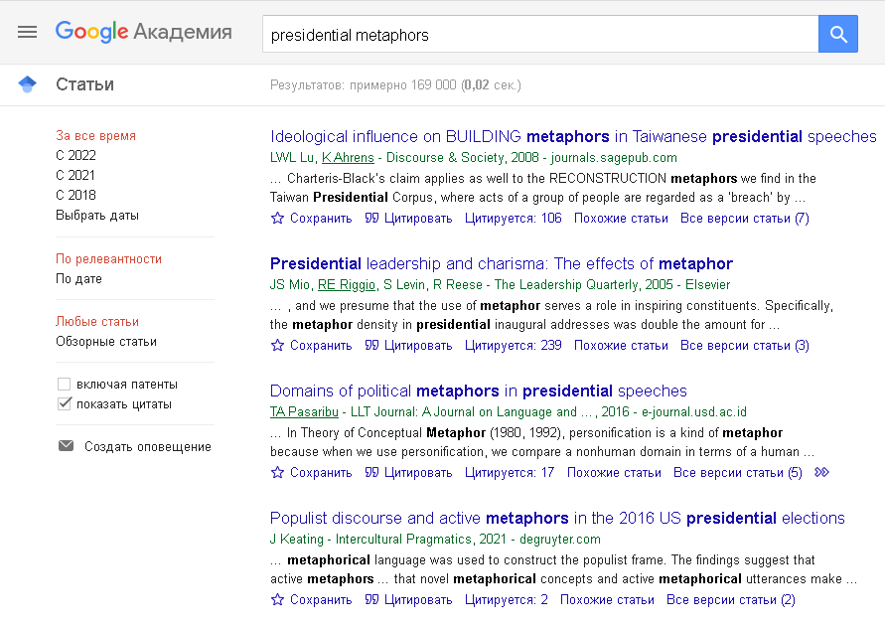
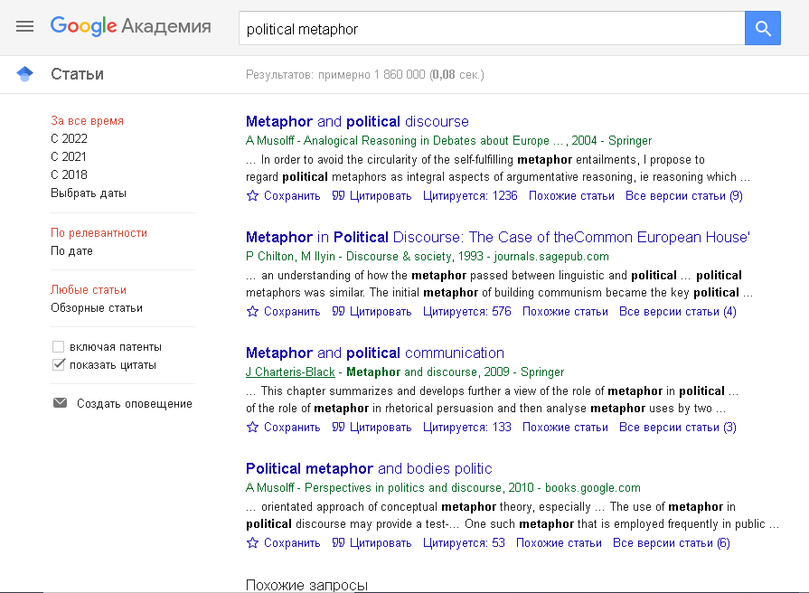
Role of metaphor in decision-making

Slide 24
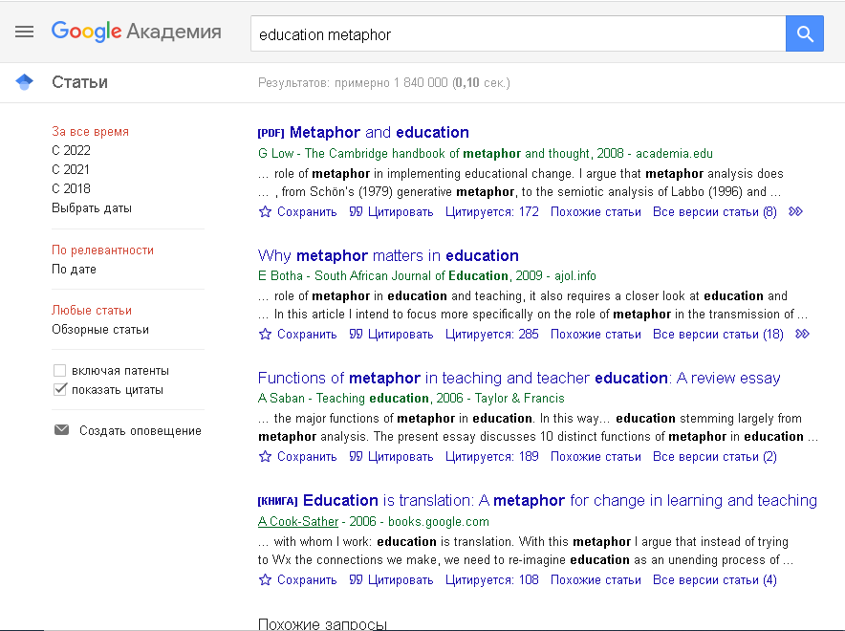
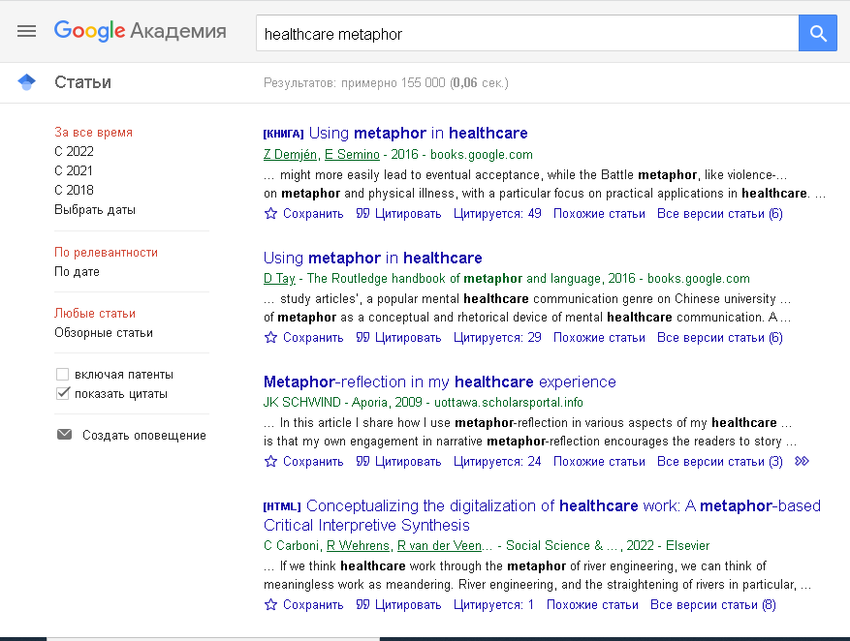
Role of metaphor in decision-making

Slide 25
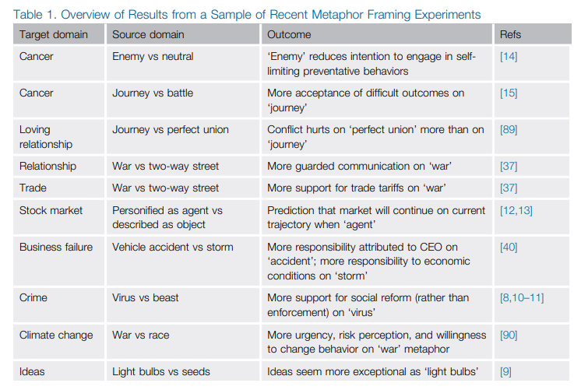
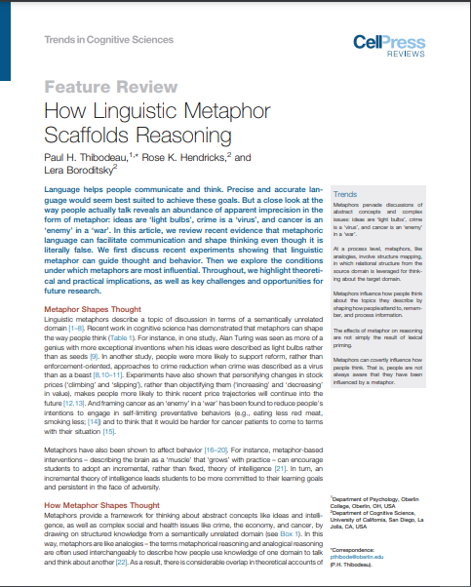
Role of metaphor in decision-making

Slide 26


2012-2015
https://metaphor.icsi.berkeley.edu/pub/en/index.php/MetaNet_Metaphor_Wiki

Slide 27
Metaphor
powerful cognitive tool
ubiquitous in discourse
fundamental part of the language system
creates ambiguity
Challenge
to NLP applications
information retrieval
machine translation
question answering
information extraction
opinion mining, etc.

Slide 28
metaphor identification
metaphor interpretation
computational studies: implications for metaphor theory
metaphor generation

Slide 29
Paradigm: top down (deductive)
mapping
TARGET
abstract
SOURCE
concrete
1
Conceptual metaphor: POVERTY IS A DISEASE
Literature, databases, e.g.
Lakoff et al. 1991
Dodge et al. 2015
Linguistic metaphors:
The epidemic (Source) of poverty (Target) is spreading in America...
... we can't treat the symptoms (Source) of poverty (Target) in isolation.
2

Slide 30
Paradigm: bottom up (inductive)
2
TARGET:
POVERTY
mapping
SOURCE:
DISEASE
The epidemic of poverty is spreading in America... → MET
The epidemic of Covid-19 is spreading in America... → NONMET
... we can't treat the symptoms of poverty in isolation. → MET
... we can't treat the symptoms of pneumonia in isolation. → NONMET
Corpus
1

Slide 31
Top down vs. bottom up
Top down:
potentially limited set of linguistic expressions
relatively easier to implement
prone to bias towards preconceived conceptual metaphors
conceptual mappings: intuition-based, criticized
Bottom up:
reduces the bias towards preconceived CMs
relatively more systematic and controlled → annotation protocols
open set of linguistic expressions
technically more challenging
+
+
+
+
-
-
-
-
Most work is focused on the first step – identification of linguistic metaphors in raw text
Notes:
“When a word or phrase like ‘defend’, ‘position,’ ‘maneuver’, or ‘strategy’ is used, there is no a priori way to determine whether the intended underlying conceptual metaphor is an athletic contest or a game of chess.” This view goes against Lakoff and Johnson (1980a), who have postulated single conceptual metaphors but neglected the fact that they can be interpreted in several different ways. The same is true of linguistic expressions: referring to research by Gentner and Bowdle (2001), Kövecses (1995) and Radman (1997), Ritchie (2003, p. 128) points out that “the evidence thus far is consistent with the idea that many everyday phrases represent overlapping interlocking systems of metaphor, affording many possible interpretations.” Vervaeke and Kennedy (1996) also stress that a metaphor on a linguistic level may be interpreted according to multiple underlying conceptual metaphors and is not necessarily a surface expression of a single cross‑domain mapping.

Slide 32

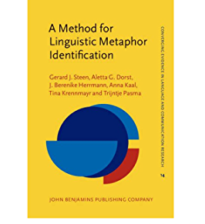
Linguistic metaphor : MIPVU Procedure and VU Amsterdam Metaphor Corpus
Identify the contextual meaning of the lexical unit.
Check if there is a more basic meaning of the lexical unit. A more basic meaning of a lexical unit is defined as a more concrete, specific, and human‑oriented sense in contemporary language use.
Determine whether the more basic meaning of the lexical unit is sufficiently distinct from the contextual meaning.
Examine whether the contextual meaning of the lexical unit can be related to the more basic meaning by some form of similarity.
http://www.vismet.org/metcor/search/showPage.php?page=start

Slide 33
Linguistic metaphor : MIPVU Procedure and VU Amsterdam Metaphor Corpus
Normally routines are single chains of instructions although it is possible to have some conditional branching.
Arlene …looked on Paula as her very own creation . The raw materials might have been there before — indeed , hadn't it been she , Arlene , who had spotted them ? But the transformation of a leggy young filly into a sleekly beautiful racehorse had been her doing . Eighteen months in the model business had eliminated all trace of her former Somerset accent .

Slide 34
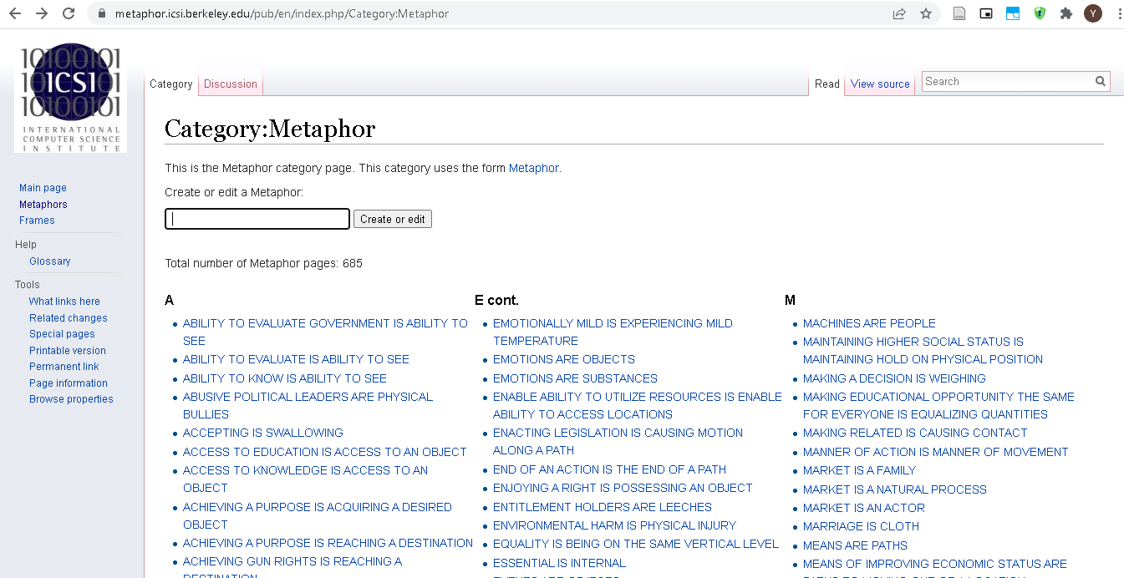
Conceptual metaphor: The MetaNet Repository
https://metaphor.icsi.berkeley.edu/pub/en/index.php/Category:Metaphor
Dodge, E., Hong, J., & Stickles, E. (2015). MetaNet: Deep semantic automatic metaphor analysis.

Slide 35
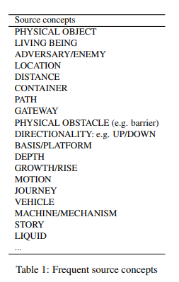
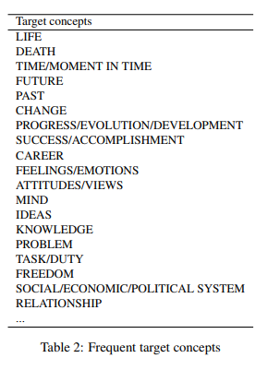
Conceptual Metaphor: Metaphor Corpus Annotated for Source-Target Domain Mappings
761 sentences, 13642 words from BNC
3 annotators, agreement 0.61 (κ)
If he asked her to post a letter or buy some razor blades from the chemist, she was transported with pleasure.
→ EMOTIONS ARE VEHICLES
Shutova, E., & Teufel, S. (2010).
http://citeseerx.ist.psu.edu/viewdoc/download?doi=10.1.1.415.1260&rep=rep1&type=pdf

Slide 36
Russian corpus of verbal linguistic metaphor
RusMet (Badryzlova & Panicheva, 2018)
~7,000 sentences
20 target verbs (e.g бомбардировать ‘to bombard’, нападать ‘to attack’, взрывать ‘to explode (smth)’, взвешивать ‘to weigh’, etc.)

Slide 37
20 polysemous Russian verbs
Inter-annotator agreement:
3 annotators
20% of sentences from each verb
Fleiss’ kappa: 0.91
razbavlyat - to dilute, to liquefy (smth)
syedat - to eat (smth) up
trubit - to blow a trumpet
ukolot - to prick (smth/smb)
utyuzhit - to iron (clothes)
vykraivat - to cut (in sewing: parts of a garment, from fabric)
vzorvat - to blow (smth) up, to explode (smth)
vzvesit - to weigh (smth)
zazhigat - to ignite (smth)
zhonglirovat - to juggle (smth)
bombardirovat - to bombard (smth/smb))
doit - to milk (e.g. a cow)
gret - to heat (smth) up
napadat - to attack (smth/smb)
ochertit - to outline (smth)
otrubit - to hack (smth) off
pilit - to saw (smth)
podkhvatyvat - to catch (smth falling)
prichesat - to comb (smth/smb)
raspylyat - to spray (smth)
Notes:
Он состоит из предложений, каждое из которых содержит один из 20 представленных на этом слайде многозначных глаголов.

Slide 38
Two classes: MET and NONMET
(MET) Самолюбие – это наполненный ветром воздушный шар, из которого вырывается буря, лишь < уколешь > его .
(MET) [Она] не собиралась со мной поссориться, просто < уколола > меня по привычке.
(NONMET) А маникюрша, помнится, как-то до крови < уколола > мне палец.

Slide 39
Conventionalized vs. novel metaphors
Зависть подобна моли в одеждах : та < < съедает > > одежду , а эта – сердце , в котором зародится .
Программа о здоровье под руководством Елены Малышевой в последнее время просто < < взорвала > > российский интернет!
Мысль < < уколола > > и ушла, как поезд, но в груди остался непонятный холод.
Я же не кинулся на него с бухты-барахты, а тщательно все < < взвесил > > !

Slide 40
How can metaphor be captured computationally?
Notes:
Он состоит из предложений, каждое из которых содержит один из 20 представленных на этом слайде многозначных глаголов.

Slide 41
Придя на кладбище, хорошо < < зажечь > > свечу и хотя бы кратко помолиться об умершем.
Своей страстью ей удалось < < зажечь > > супруга, канадца Уильяма Макдугалла.
< < Зажигайте > > с нами под музыку в стиле «Диско»!
Иногда , для того , чтоб успеть на работу , приходится < < греть > > воду в электрочайнике !
Но душу < < грела > > мысль , что впереди грядет продолжение .
Вы < < греете > > и освещаете все вокруг .
Зачем, разве тебя недостаточно < < причесали > > дубинкой по голове?
В первый день после взрыва, пока информацию не " < < причесали > > ", картина выглядела по-другому.
Нас загримировали, < < причесали > > , как и других участников.
Notes:
Он состоит из предложений, каждое из которых содержит один из 20 представленных на этом слайде многозначных глаголов.

Slide 42
Features for ML metaphor identification
lexical
morphological and syntactic
distributional semantic
psycholinguistic: e.g. concreteness-abstractness
topic modelling
lexical thesauri and ontologies (e.g. WordNet, FrameNet, VerbNet, ConceptNet, SUMO ontology)

Slide 43
Motivation
mapping
TARGET
SOURCE

Slide 44
MetaNet: Repository of metaphor constructions
Dodge, E., Hong, J., & Stickles, E. (2015). MetaNet: Deep semantic automatic metaphor analysis.

Slide 45
Bottom-up paradigm
Identification of linguistic metaphor

Slide 46
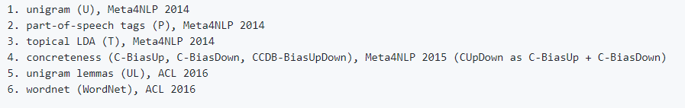
Second shared metaphor detection task (Leong et al. 2020)
VUAMC dataset: 117 texts covering four genres (academic, conversation, fiction, news).
TOEFL dataset: 180 (train) / 60 (test) essays
Tracks: (a) verbs only, (b) all content part-of-speech
https://competitions.codalab.org/competitions/22188
Klebanov, B. B., Leong, C. W., & Flor, M. (2018). A corpus of non-native written English annotated for metaphor.

Slide 47
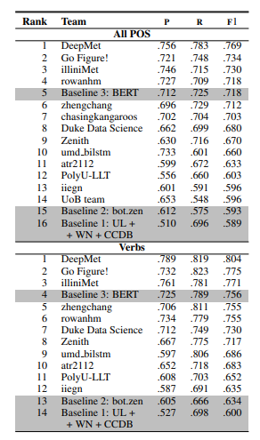
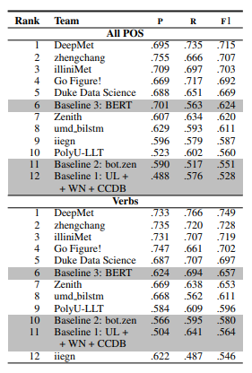
Second shared metaphor detection task (Leong et al. 2020)
VUAMC
TOEFL

Slide 48
Metaphor identification in Russian
Bottom-up paradigm
Linguistic metaphor, verbs
RusMet corpus
Badryzlova, Y. (2019). Automated metaphor identification in Russian texts
Badryzlova, Y., Nikiforova, A., & Lyashevskaya, O. (2020). Do topics make a metaphor? Topic modeling for metaphor identification and analysis in Russian.

Slide 49
Feature set

Slide 50
1. Distributional semantic feature
word‑embeddings: pre-trained models
(RusVectōrēs – Kutuzov & Kuzmenko, 2016)
semantic similarity measure (Newman et al., 2010):
mean pairwise similarity of all content words (with / without the target verb)

Slide 51
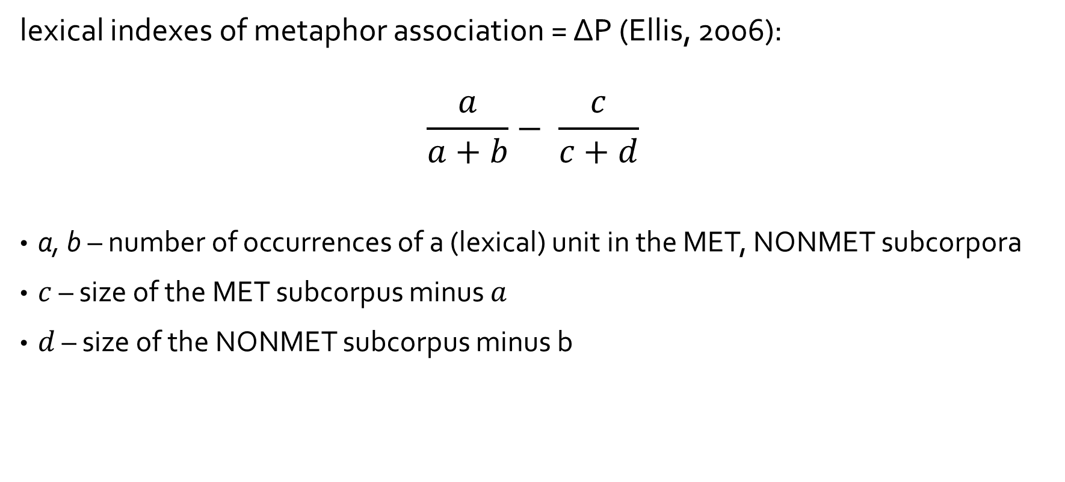
2. Lexical feature
lexical indexes of metaphor association = ΔP (Ellis, 2006):
$$\frac{a}{a+b}− \frac{c}{c+d}$$
a, b – number of occurrences of a (lexical) unit in the MET, NONMET subcorpora
$c$ – size of the MET subcorpus minus $a$
$d$ – size of the NONMET subcorpus minus b

Slide 52
3. Morphosyntactic feature
morphosyntactic indexes of metaphor association
ΔP on morphosyntactic unigrams (POS-tags)

Slide 53
4. Concreteness-abstractness feature
Abstract paradigm (excerpt) |  | Concrete paradigm (excerpt)
домашность | 'domesticity' | арфа | 'harp'
мечтательность | 'reverie' | теплоход | 'motorship'
автоматизм | 'automatism' | зеркальце | 'compact mirror'
распутство | 'promiscuity ' | пельмени | 'dumplings'
чрезвычайность | 'extraordinariness' | электрогитара | 'electric guitar'
партийность | 'party affiliation' | гранатомет | 'grenade launcher'
активация | 'activation' | линейка | 'ruler'
буддизм | 'Buddhism ' | фуганок | 'jointer plane'
правильность | 'correctness' | узелок | 'knot'
минимализм | 'minimalism' | полупальто | 'short coat'
KartaSlov (Kulagin, 2017, 2019)

Slide 54
4. Concreteness-abstractness feature
CONCRETE PARADIGM
word 1
word 2
word 3
…
word n
ABSTRACT PARADIGM
word 1
word 2
word 3
…
word n
semantic similarity
semantic similarity
word from corpus
word from corpus
mean of
10 nearest neighbors
mean of
10 nearest neighbors
Mean = concreteness-abstractness index

Slide 55
5. Topics feature¹
Topic models: LDA and ARTM² (dense and sparse)
Trained on Russian Wikipedia
¹ Nikiforova, 2020
²Vorontsov, Potapenko, 2014

Slide 56
Experimental setup
sentence‑level binary classification
SVM, Logistic Regression, Neural Network (multilayer perceptron)
5‑fold cross‑validation

Slide 57
Results

Slide 58
feature / classifier | Acc*
LEX | 0.817
SEM | 0.731
CONC | 0.716
TM | 0.703
MORPH | 0.675
LEX+SEM | 0.848
LEX+CONC | 0.833
LEX+TM | 0.829
LEX+MORPH | 0.820
LEX+MORPH+CONC | 0.835
LEX+MORPH+SEM+CONC | 0.854
LEX+MORPH+SEM+CONC+TM | 0.854
*Logistic regression; TM – LDA with 80 features

Slide 59
Project repository
Anastasia Nikiforova
https://github.com/steysie/topic-modelling-metaphor
Specifically, see
https://github.com/steysie/topic-modelling-metaphor/blob/master/Notebooks%20and%20Scripts/%5B2%5D%20Topic%20Model%20Metaphor%20Classifier.ipynb

Slide 60
Analysis

Slide 61
Possible lexical predictors of metaphoricity
Robustness of lexical feature
~230 words
(Random Forest feature importance)

Slide 62
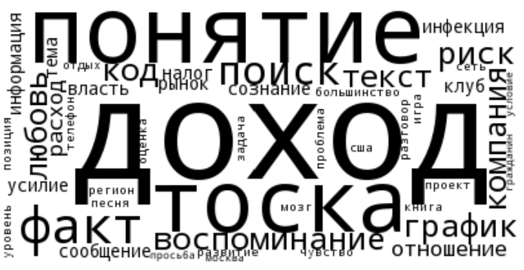
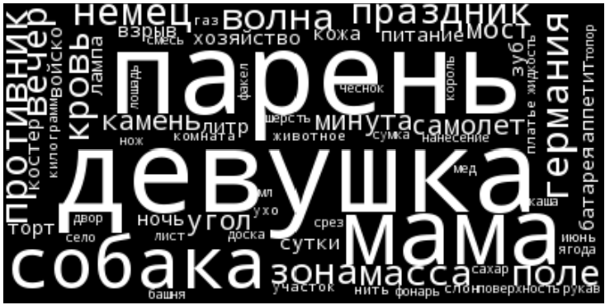
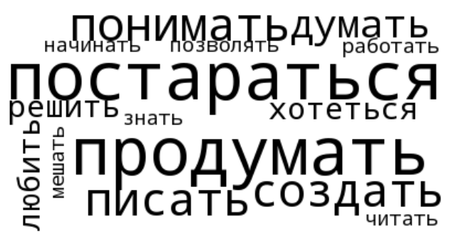
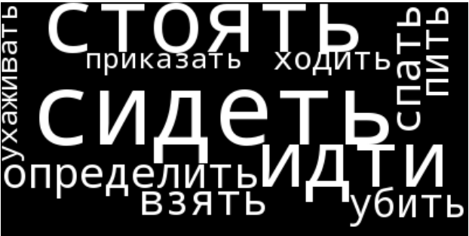
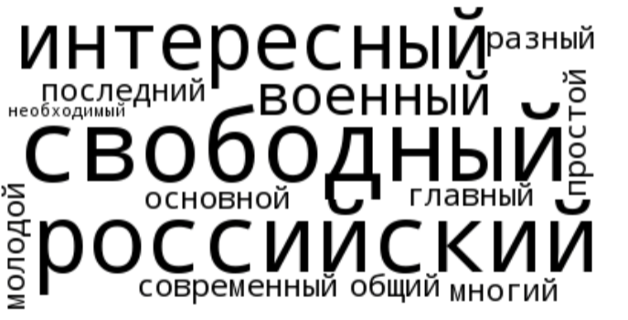
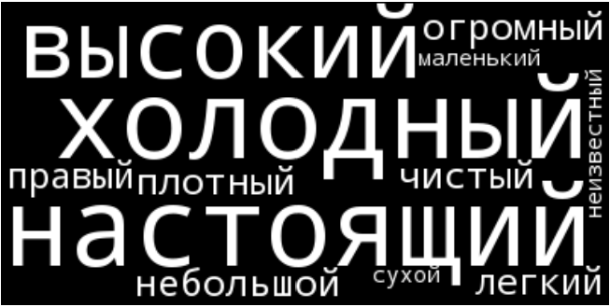
Nouns
MET
NONMET
Verbs
Adj

Slide 63
CONCEPTUAL METAPHOR THEORY
NONMET discourse is more concrete, related to physical experience
MET discourse is more abstract
Lakoff et al. 1991

Slide 64
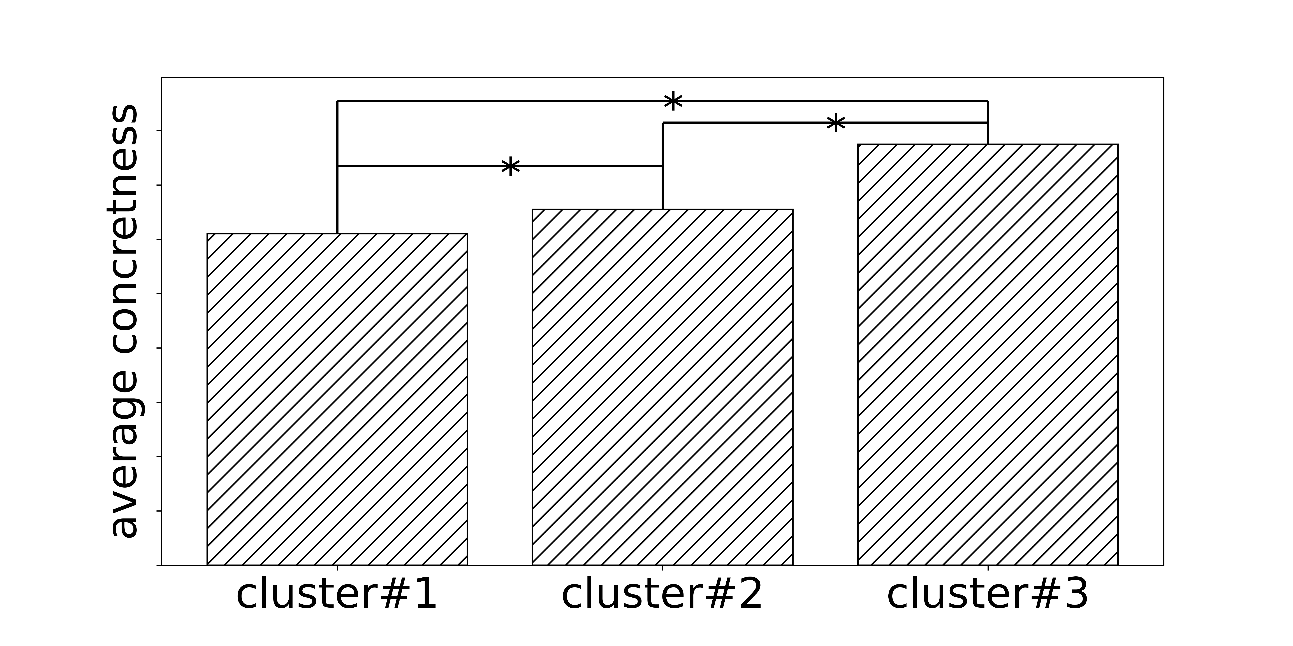
CONCEPTUAL METAPHOR THEORY
NONMET discourse: more concrete
MET discourse: more abstract
metaphor association (ΔP)

Slide 65
CONCEPTUAL METAPHOR THEORY
MET discourse: Source and Target domains
NONMET discourse: only Source domain
Hypothesis: MET is semantically more heterogeneous than NONMET
SemSim = pairwise semantic similarity of words in a sentence
mean SemSim of MET < mean SemSim of NONMET
statistically significant (Mann-Whitney U-test)

Slide 66
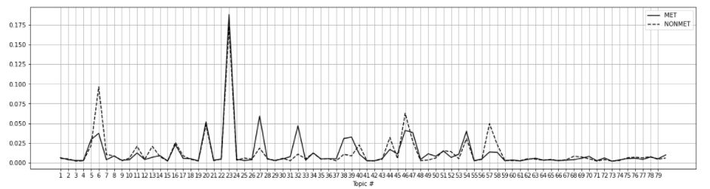
Topical cues of metaphoricity
MET: Literature and Writing, Economy, Judicial System, Corporate Management, Railway
NONMET: Biology, Language, Cars, Chemistry, Aviation, Peoples and Traditions, Religion
MET and NONMET: Military and Warfare, Cinema, TV Series and Computer Games, Architecture and Construction

Slide 67
Hypothesis: topics as proxies for conceptual domains
mapping
TARGET
SOURCE

Slide 68
MET discourse: Source and Target domains
NONMET discourse: only Source domain
Hypothesis: MET is thematically more heterogeneous than NONMET
latent profile analysis: insufficient evidence
mclust: https://mclust-org.github.io/mclust/

Slide 69
Morphological cues
(Random forest feature importance)
MET
superlative adjectives (важнейший, величайший, крупнейший, etc.)
particles – sentential focus, rhetoric function (же , только , даже , просто , вот , лишь , ли , именно)
verbs: first and second person
NONMET
numerals and quantifiers
greater degree of emotionality, modality, or speaker-centricity

Slide 70
Conclusions

Slide 71
Robustness of lexical feature (consistent with previous work, e.g. Klebanov et al. 2014 for English)
Lexical cues of metaphoricity
MET is semantically more heterogeneous than NONMET:
MET is thematically more heterogeneous than NONMET: insufficient evidence
Topical cues of metaphoricity – reflect topics, not conceptual mappings
NONMET is more concrete than MET
Morphological cues of metaphoricity – genre, domain, and pragmatic characteristics of discourse

Slide 72
LIMITATION
Size and design of experimental corpus
One language

Slide 73
Selected References
Please follow the link
https://docs.google.com/document/d/1FSnvHgf0ZOXpx8m84M4aa49OaMd7R6vNIiCHSVjdJjY/edit?usp=sharing

Slide 74
Thank you

